Slide 1
Getting it Right For Every Child : Policy and Practice Overview
Ronnie Hill Consultancy Ltd
ronniejthill@ymail.com

Slide 2
Getting it right for every child – Scottish Policy since 2006
Aims:
To improve outcomes for all children by working better together
To change culture, systems and practice
To provide a framework to support consistent approach/practice across services in public and 3rd sector
Build good quality universal services to meet needs and more specialist services for children who need these
Provide the right help at the right time

Slide 3
Getting it right for every child - values and principles
Promoting the wellbeing of individual children and young people by taking a whole child approach
Building on strengths and promoting resilience
Valuing diversity and promoting fairness
Keeping children and young people safe
Putting the child at the centre and working in partnership with families

Slide 4
Getting it right for every child - values and principles
Providing additional help that is proportionate, timely and coordinated where required
Supporting informed choice, respecting confidentiality and proportionate sharing of relevant and necessary information
Building the capability of the workforce to promote children’s and young people’s wellbeing
Promoting the same values across all working relationships and bringing together each worker’s expertise

Slide 5
Wellbeing Indicators
SAFE – Protected from abuse, neglect or harm at home, at school and in the community
HEALTHY – Having the highest attainable standards of physical and mental health, access to suitable healthcare, and support in learning to make healthy and safe choices
ACHIEVING – Being supported and guided in learning and in the development of skills, confidence and self esteem, at home, in school and in the community
NURTURED – Having a nurturing place to live in a family setting, with additional help if needed, or, where this is not possible, in a suitable care setting

Slide 6
Wellbeing Indicators
ACTIVE – Having opportunities to take part in activities such as play, recreation and sport, which contribute to healthy growth and development, at home, in school and in the community.
RESPECTED – Having the opportunity, along with carers, to be heard and involved decisions that affect them and are treated in a way that is reflective of their age and maturity
RESPONSIBLE – Having opportunities and encouragement to play active and responsible roles at home, in school and in the community, and where necessary having appropriate guidance and supervision and being involved in decisions that affect them
INCLUDED – Having help to overcome social, educational, physical and economic inequalities, and being accepted as part of the community in which they live and learn.

Slide 7
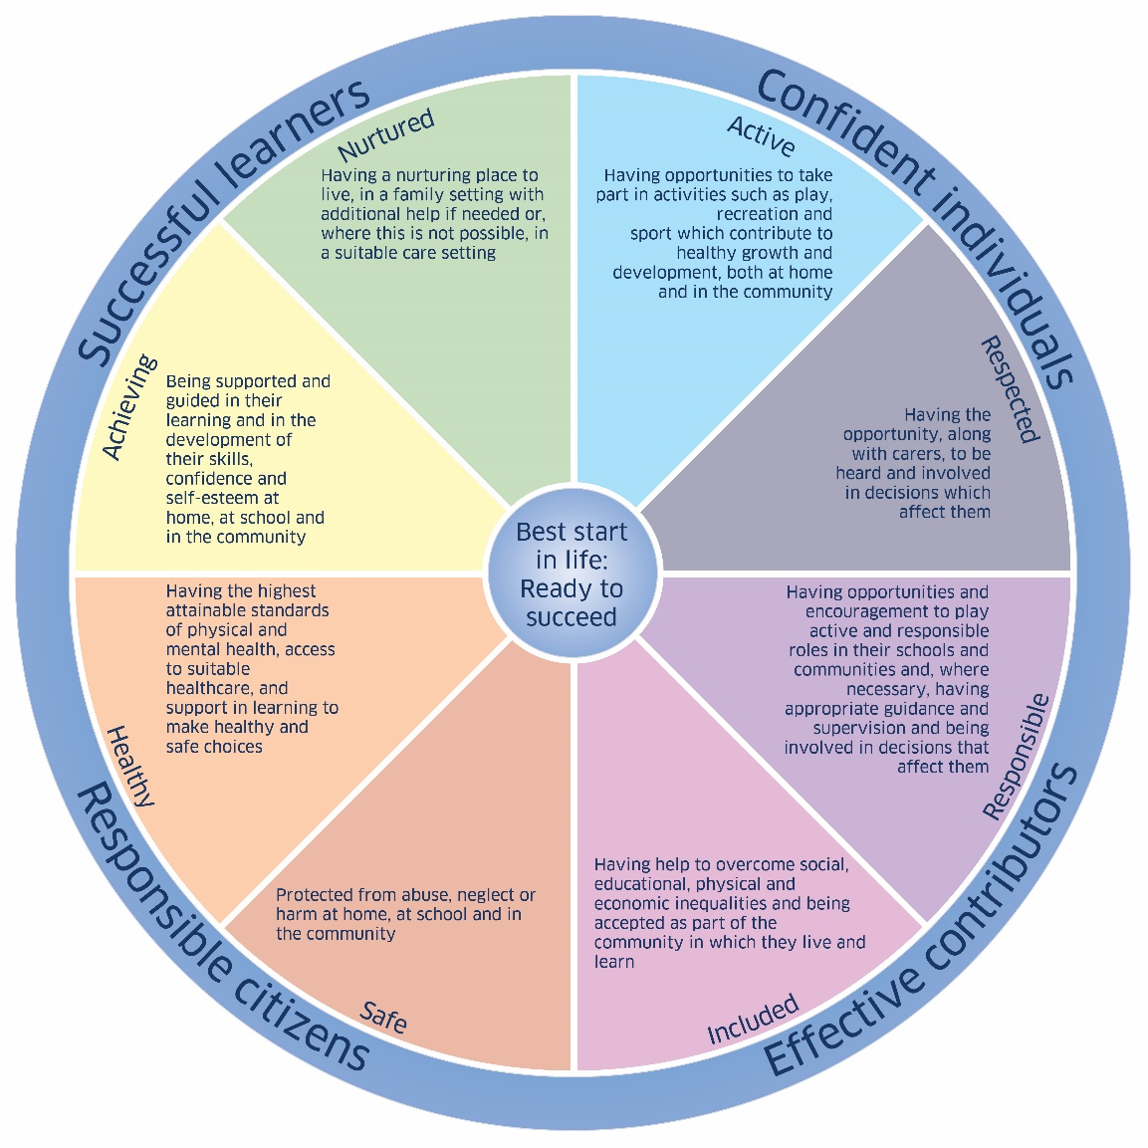
Wellbeing Wheel

Slide 8
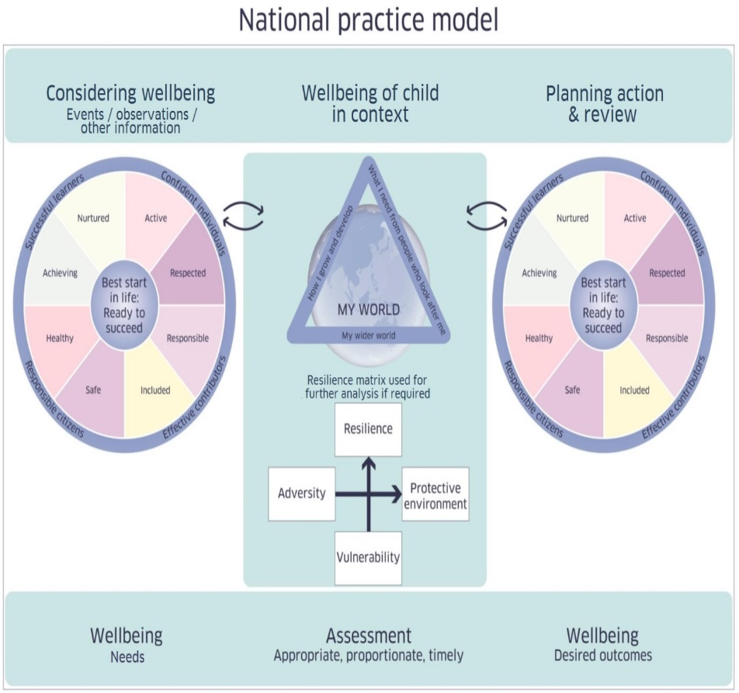
National Practice Model

Slide 9
My World Triangle

Slide 10
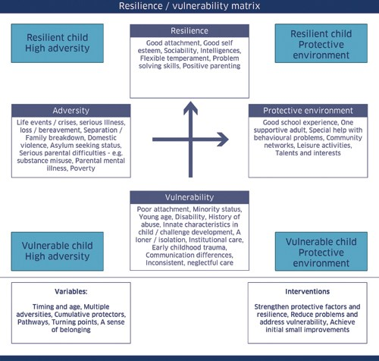
Resilience/Vulnerability Matrix

Slide 11
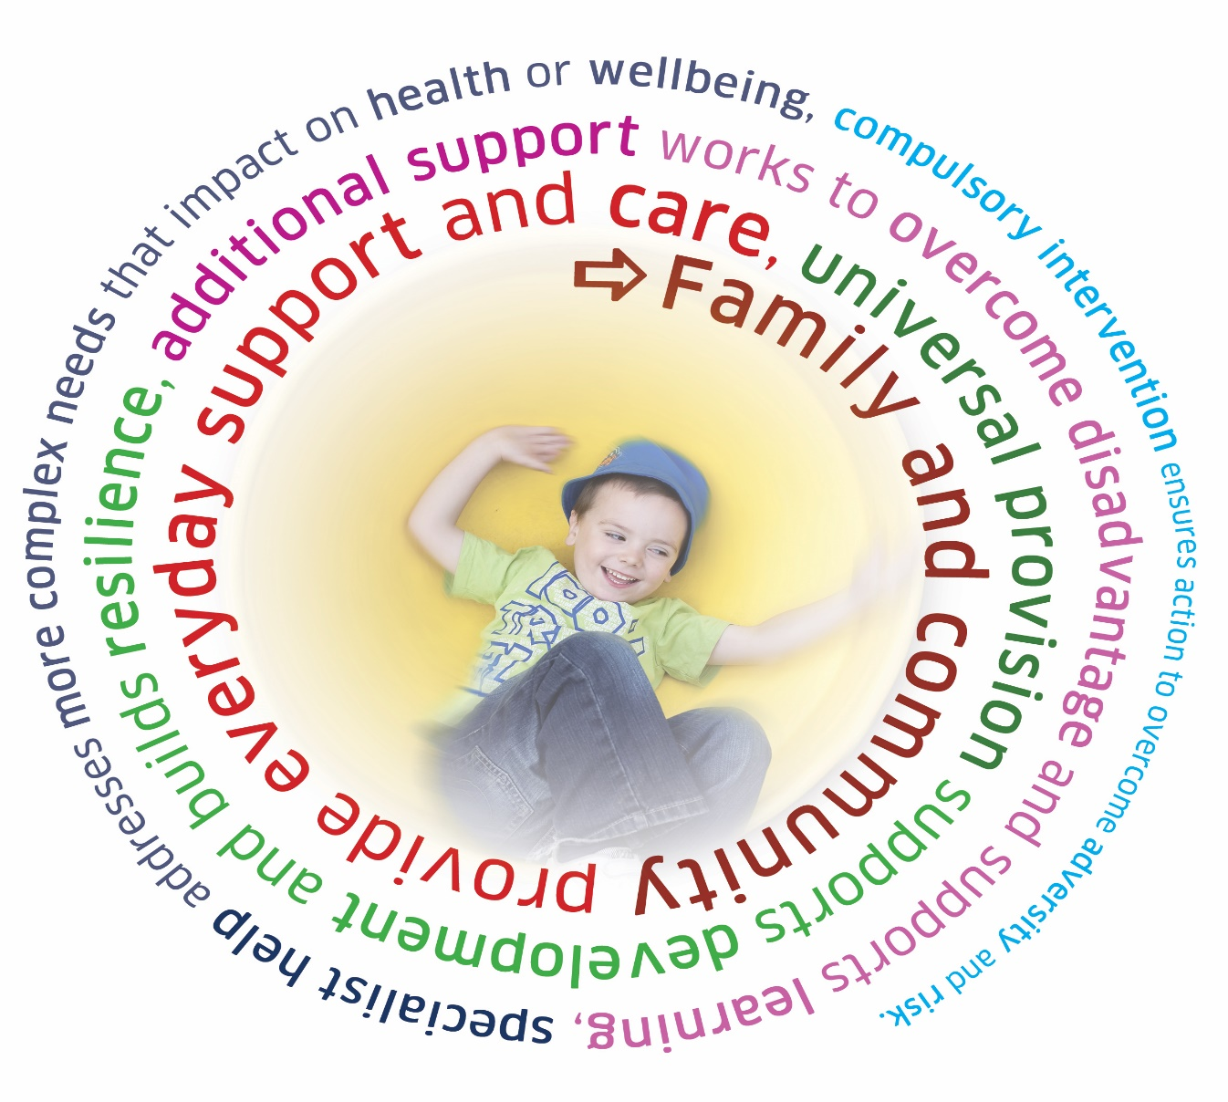
Network of Support

Slide 12
ALLIANCE Resources
Involving children, young people, parents and carers in planning to meet children’s wellbeing needs – guide for services
Getting to Know Getting It Right For Every Child - Core Materials - materials used at our Getting It Right For Every Child information sessions.
Getting to know Getting It Right For Every Child – Adult Easy Read Guides - A range of easy read guides for Parents and Carers in Word and PDF format
Getting it Right for YOUR Child: Wellbeing Activity – Helping parents to prepare for meetings with professionals
The Wellbeing Bingo Game –for groups of young people to explore issues related to wellbeing

Slide 13
Thank You
www.alliance-scotland.org.uk
@AllianceScot
Email: info@alliance-scotland.org.uk
Telephone 0141 404 0231

